Slide 1
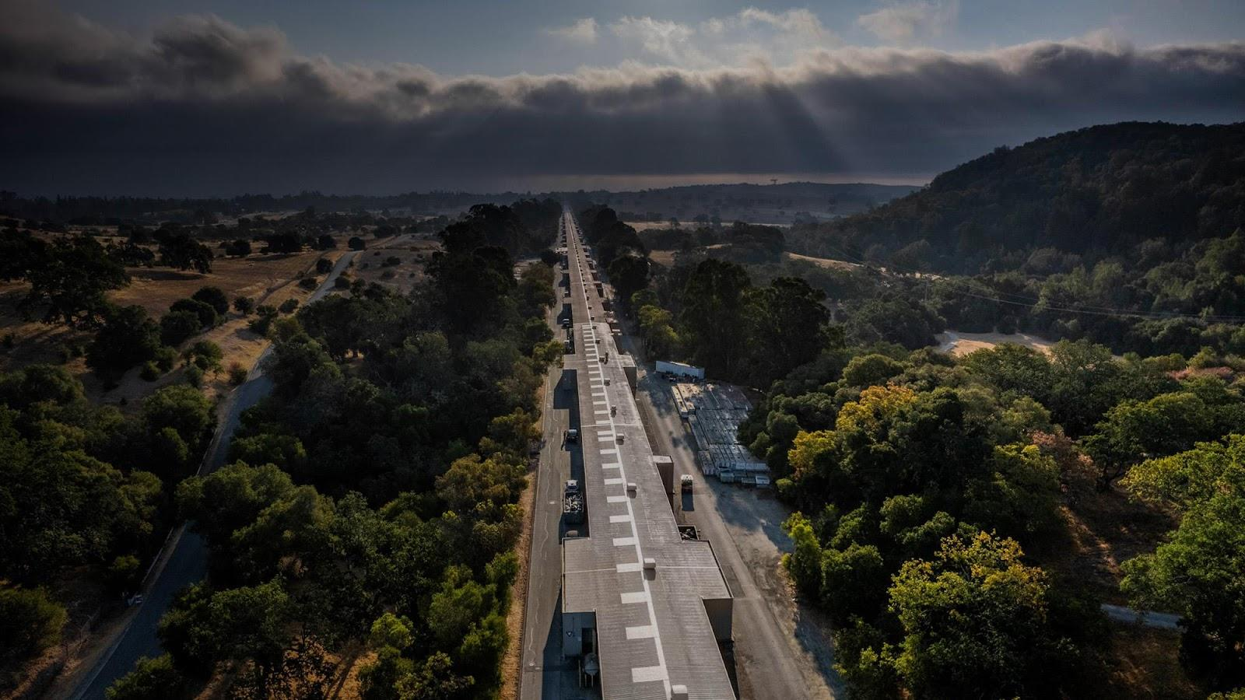


P5 Report and BDS Considerations for HALHF
Spencer Gessner, SLAC
December 18, 2023

Slide 2
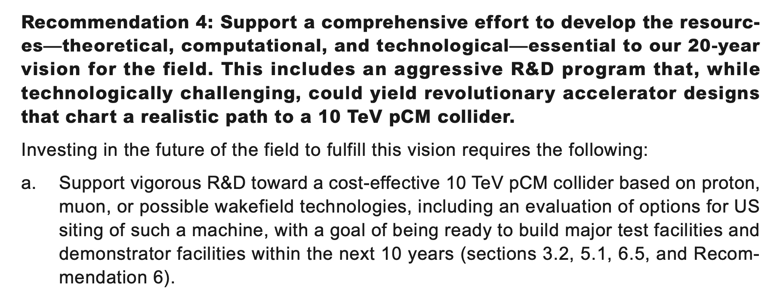
P5 Report is Positive on 10 TeV+ Wakefield Colliders
Credit to Cameron Geddes for defending the work of the advanced accelerator community in P5.

Slide 3

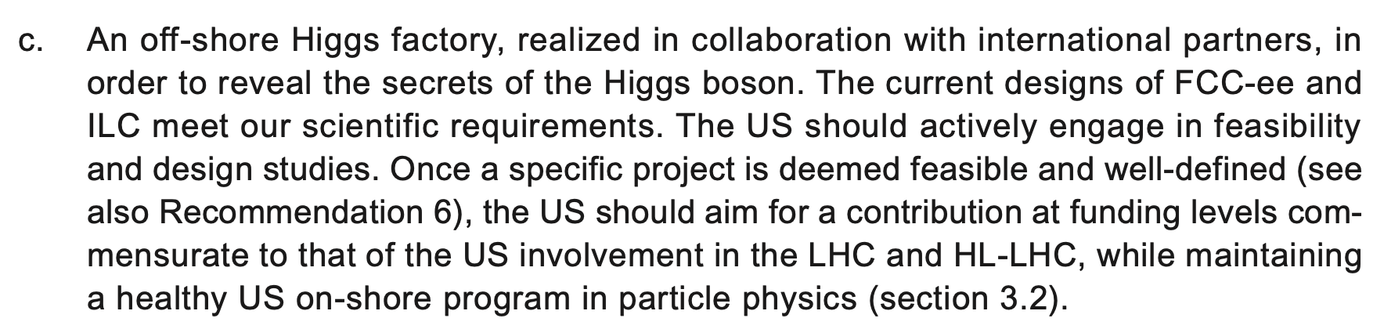
P5 Report Supports FCC and ILC
This likely means increased US involvement in ILC Technology Network (ITN)

Slide 4
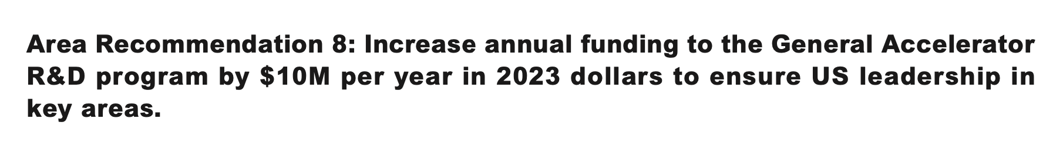
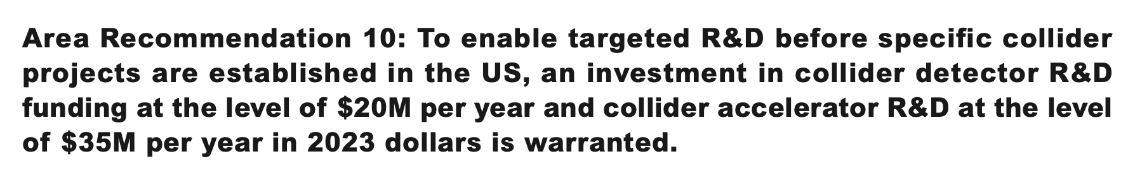
P5 Report Supports Additional Funding for Acc. R&D
Current HEP GARD funding is about $95M/year.
New GARD + Collider Accelerator R&D is $45M/year.
That’s almost a 50% increase in accelerator R&D funding!

Slide 5
P5 Report Supports Additional Funding for Acc. R&D
Even if most of the new money goes to Higgs Factories and Muon Collider, this is still a very positive report for PWFA.
Current HEP GARD funding is about $95M/year.
New GARD + Collider Accelerator R&D is $45M/year.
That’s almost a 50% increase in accelerator R&D funding!

Slide 6
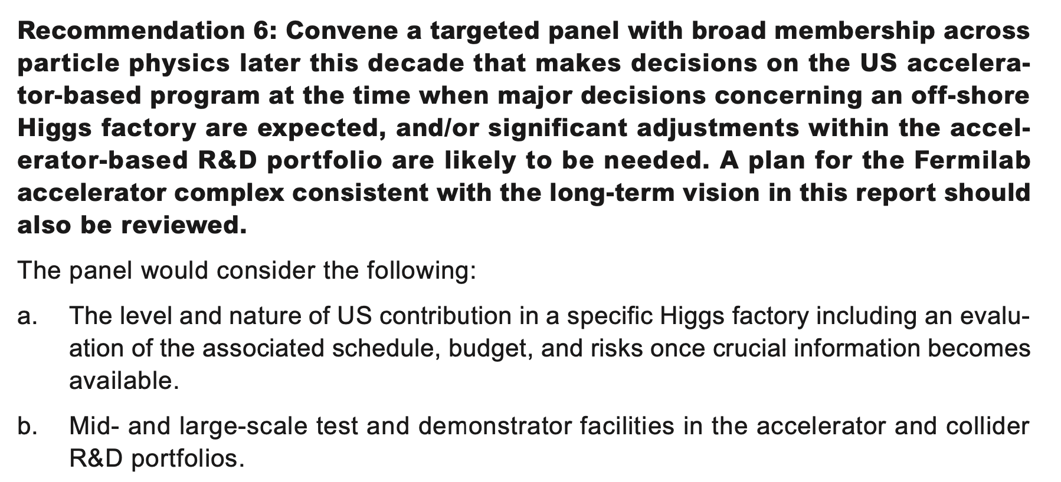
Review Panel Around Time of FCC decision
Opportunity to present collider designs around 2027

Slide 7
Commentary
At SLAC’s post-P5 meeting, Tor Raubenheimer said (paraphrasing):
  “The targeted panel is not just an opportunity, but a deadline. You need to show credible designs for 10 TeV colliders or we should go another direction.”
  My interpretation: HEP funding for a 10 TeV wakefield collider design gives AAC community enough rope to hang ourselves.
The US will fund a wakefield collider design study, but will not directly fund contributions to HALHF.
  There are many parallels between the two studies and opportunities for collaboration.

Slide 8
Next Steps (what I hope will happen)
Discussions between SLAC, LBNL, and ANL to outline a collider study group.
Likely to have similar structure to HALHF collaboration:
  Sources
  Linac
    Structure wakefield
    Beam-driven plasma
    Laser-driven plasma
  Beam delivery
    Plasma lenses
    Beam-beam studies
Establish connections with HALHF and ILC. Create “Liaison Working Groups” or directly contribute to each other’s efforts.
  Access to wide-range of expertise.

Slide 9
BDS and Beam-Beam for HALHF
From Carl:
  Give an assessment of:
    Is the current proposal [i.e., ILC BDS but with smaller beta functions] even feasible?
    How does the length or cost of each part scale with the parameters like emittance, energy, etc? Having some clarity in this would help a lot in optimising the new iteration of HALHF.
  Example questions:
    Oide limit?
    Possible to lengthen bunch in BDS?
    Remove energy collimation (achieve in linac)?
Accelerator physicists can provide menu of options, but requirements must come from physics program and detector.

Slide 10
Discussion for HALHF
The ILC design is stringent and conservative
  Zero particles lost in final doublet.
  No synchrotron photons hit inner tracker of the detector.
Accelerator requirements flow upstream from IP.
Proposal for HALHF. Create two designs:
Cheap and messy design that meets luminosity requirements
Design that matches ILC requirements (no losses, no photons)
These two designs can be used to bracket future discussions.

Slide 11
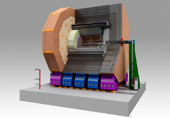
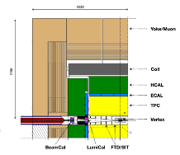
Cheap, Compact, and Messy?
Exit 𝛽 = 𝛽_{m} , 𝛼 = 0
Plasma lens
Final plasma stage
Soft dogleg
R₅₆ ≠ 0, D = 0
IP 𝛽*
L*

Slide 12
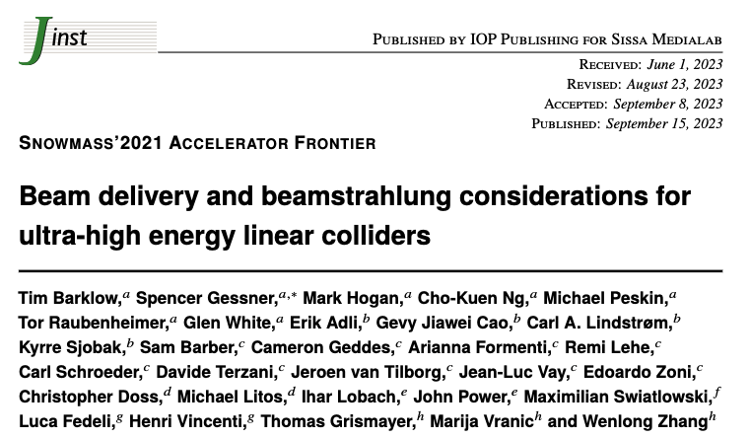
BDS and Beam-Beam
As part of Snowmass, we created a “Beam-Beam Collaboration” to start looking at issues relevant to 10 TeV colliders.
Main effort so far: develop WarpX as a replacement for GUINEA-PIG and CAIN.
  Tim Barklow (SLAC) using CAIN to model 𝛾𝛾-colliders.
  Arianna Formenti (LBNL) using GUINEA-PIG to model e⁺e⁻-colliders.
Plan to extend modeling beyond beam-beam to include:
  Plasma lenses
  Multi-foil final focus

Slide 13
First Results
In order to simulate 10 TeV collisions, we must first validate code at 250 GeV.
Arianna Formenti (LBNL) performed simulations of ILC collisions in WarpX with longitudinal resolution 128X greater than what can be achieved in GUINEA-PIG.
  Cannot show these results because still running validation and convergence tests.
  The results are really cool. . .
Please invite Arianna to present at a future HALHF meeting!
  She is aware of HALHF parameters and will simulate them next.

Slide 14
Beam-Beam Working Group
Near Term
Mid Term
Speculative
WarpX validation
QED collider studies
Contributions to ILC and C³ BDS
Plasma lenses and multi-foil focusing.
Contributions to 10 TeV pCM e+e-
Contributions to HALHF BDS
Laser-based collimation.
Contributions to 10 TeV pCM 𝞬𝞬
Design of XCC 𝞬𝞬

Slide 15
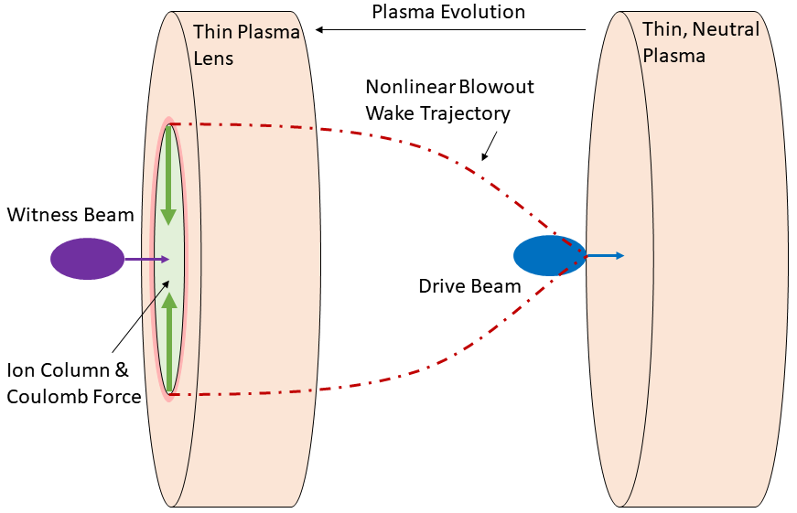
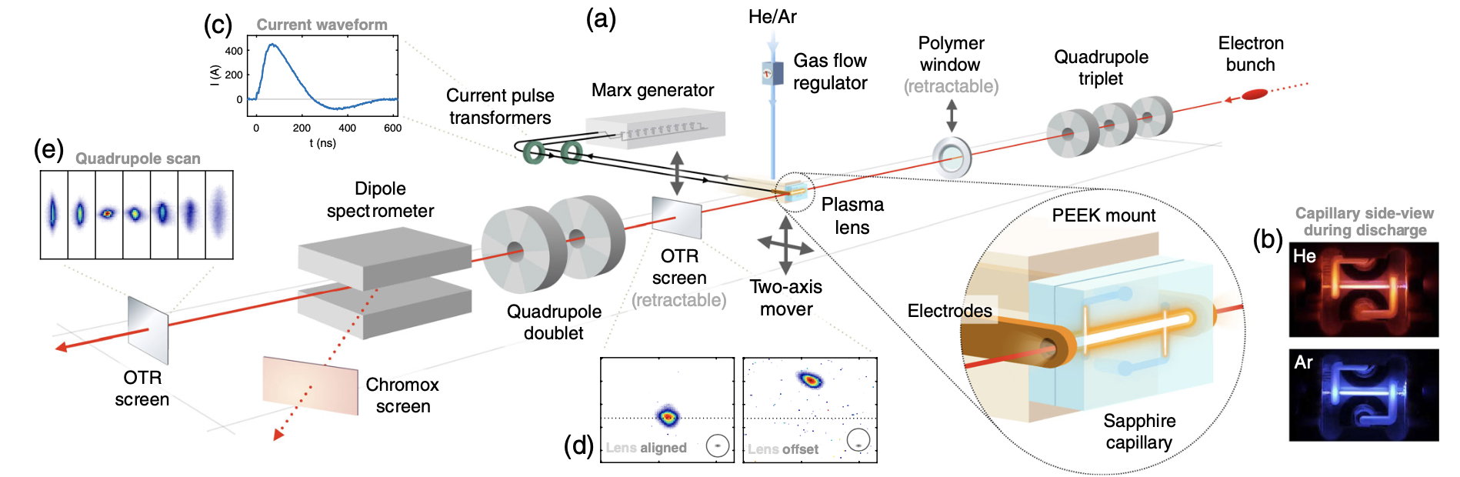
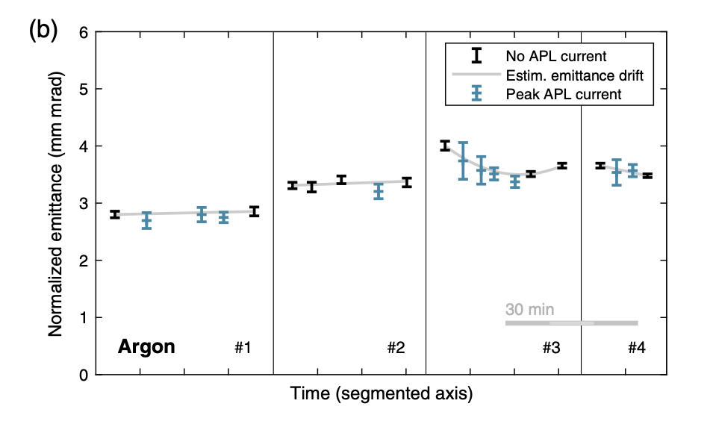
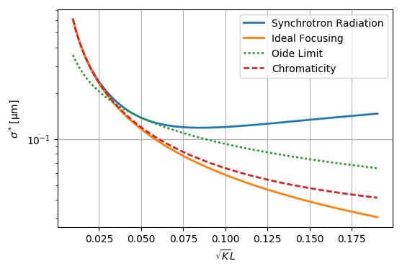
Plasma Lens Experiments
C. A. Lindstrøm et al. “Emittance Preservation in Aberration-Free Plasma Lens.” PRL (2018)
C. Doss, M. Litos, CU Boulder
E308: Passive Plasma Lens Experiment

Slide 16
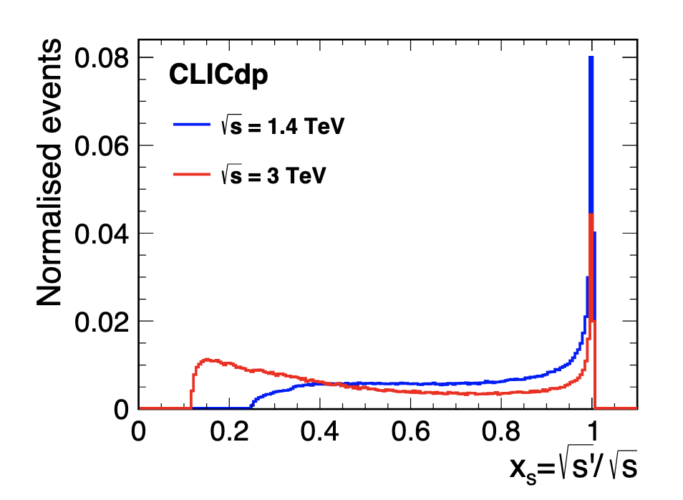
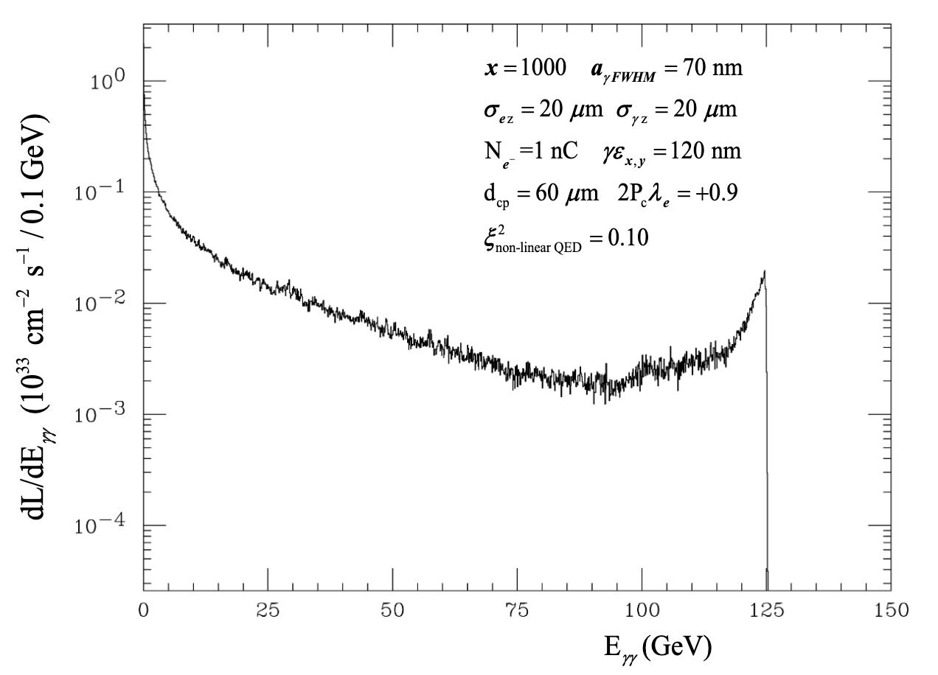
Beam-Beam Codes
GUINEA-PIG, Author: D. Schulte
CAIN, Author: K. Yokoya
GUINEA-PIG and CAIN are well-established, well-benchmarked codes, but they have their limitations. For example, they do not compute the fields of electron-positron plasmas produced under conditions of extreme beamstrahlung.

Slide 17
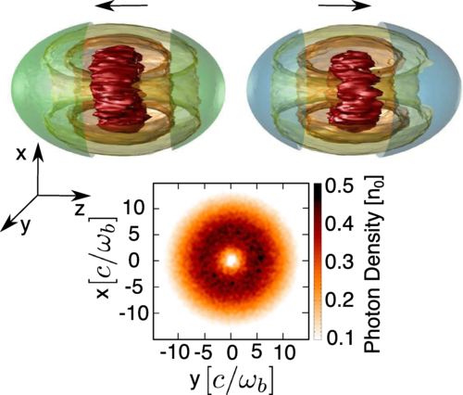
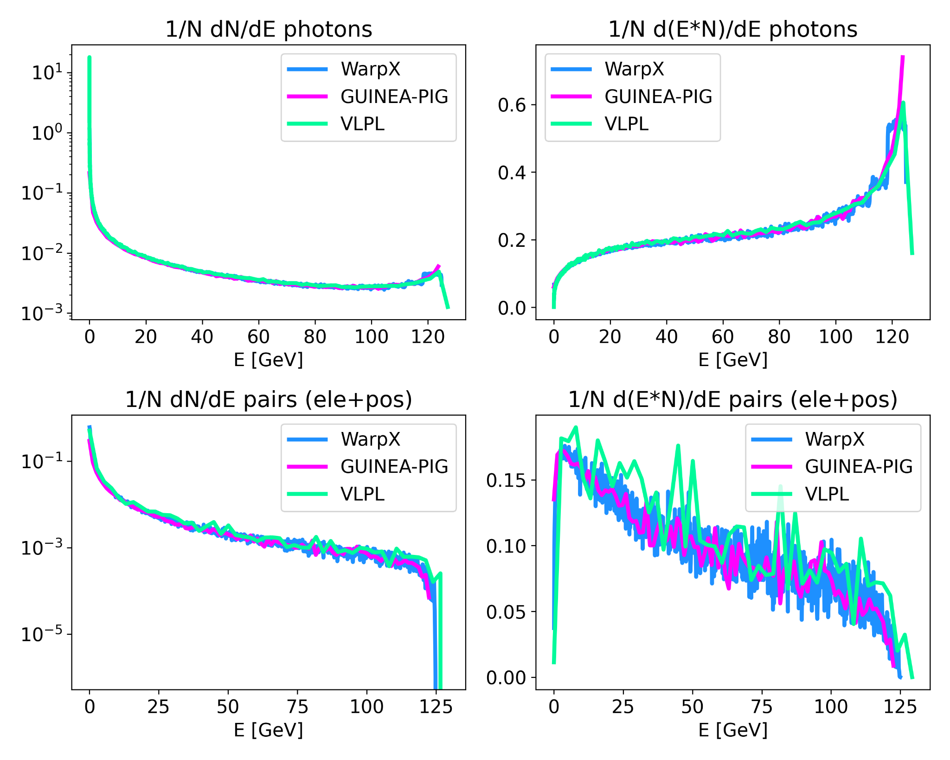
NLQED in PIC
F. Del Gaudio et al. “Bright γ rays source and nonlinear Breit-Wheeler pairs in the collision of high density particle beams.” PRAB (2019)
A. Formenti, LBNL: Comparison of WarpX and GUINEA-PIG for extreme beams
Growing interest in laser-plasma community to develop PIC codes for NLQED experiments and to support beam-beam simulations.

Slide 18
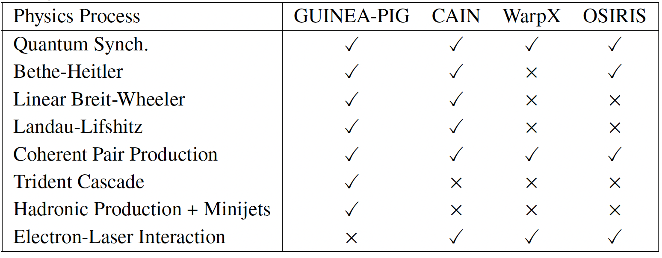
Plan for QED PIC codes
GUINEA-PIG, CAIN: beam-beam codes with 2D Poisson solves of beam slices for EM fields effects
OSIRIS, VLPL, WarpX: Electromagnetic Particle-In-Cell codes with 3D Maxwell solves for EM field effects

Slide 19
Plan for QED PIC codes
GUINEA-PIG, CAIN: beam-beam codes with 2D Poisson solves of beam slices for EM fields effects
OSIRIS, VLPL, WarpX: Electromagnetic Particle-In-Cell codes with 3D Maxwell solves for EM field effects
Testing now
Plan to test codes in well-benchmarked regimes (e.g. ILC 250 GeV) and demonstrate significant speedup, convergence, and accuracy.

Slide 20
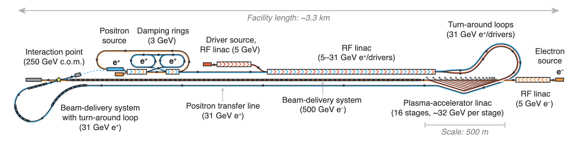
BDS for HALHF
“The HALHF beam-delivery system (BDS) is, unsurprisingly, highly asymmetrical. It is modelled here on that for the ILC, which is designed for the same energy (500 GeV). . . it can be seen that the electron BDS is in fact the driver for the total length of the HALHF facility. This strongly motivates further research into more compact beam-delivery systems.”

Slide 21
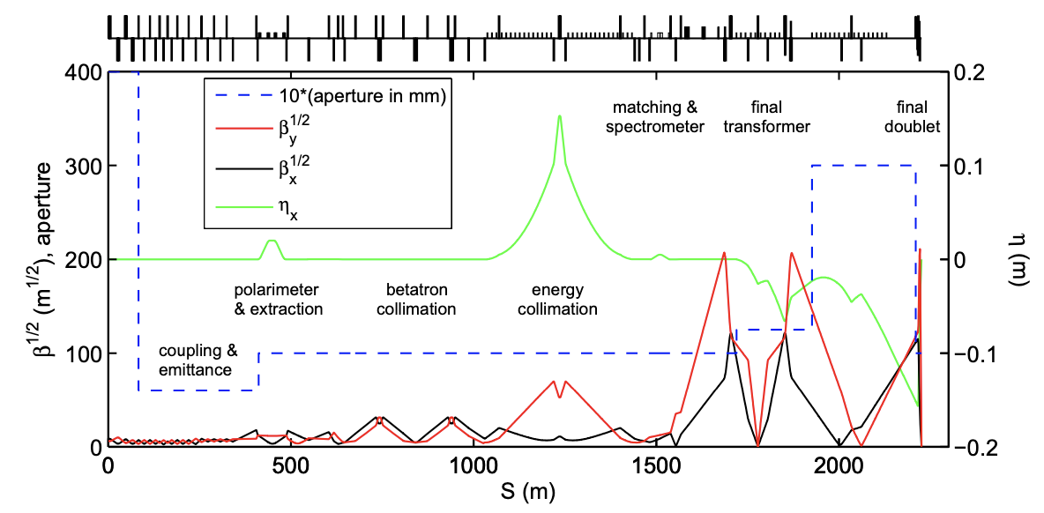
ILC BDS

